Slide 1
CAPSTONE PROJECT PORTFOLIO
Workforce Gap Analysis &
Power BI Strategic Analytics
Quantifying Capability Shortfalls, Star Schema Architecture, DAX Measures Library, and Phased Capital Deployment
TRANSFORMATION TARGET
+401 Net FTE Gap
Baseline 364 → Y3 Target 765 FTEs across 6 critical tech roles.
FINANCIAL AUTHORIZATION
$46.10M Allocated Spend
Preserves $5.0M contingency reserve + $3.9M buffer under $50M ceiling.
INTERNAL MOBILITY
41.6% Conversion Rate
167 internal reskills exceeding CHRO's 40% strategic mandate.

Slide 2
CAPSTONE PROJECT PORTFOLIO
Business Case Scenario & Strategic Mandate
Corporate Strategic Context
36-Month DTP Program: GlobalTech is 18 months into modernizing cloud banking infrastructure, automated lending, and omnichannel advising.
Human Capital Bottleneck: Technology delivery is on track, but severe skill deficits threaten rollouts and increase operational vulnerability.
Board Budget Ceiling: Executive leadership established a strict $50.0M total financial authorization ceiling across FY2025–FY2027.
Audit Compliance Urgency: Cybersecurity Specialists face an unyielding Q4 2024 compliance audit requiring immediate Year 1 expansion.
Core Transformation Directives
• 40% Internal Mobility Target: CHRO mandated at least 40% of net headcount gaps be filled via internal reskilling. Achieved: 41.6% (167 FTEs).
• Cost Efficiency via Reskilling: Reskilling Traditional Advisors saves ~$7.8M in recruiter commissions vs. direct external hiring.
• Turnover Mitigation Strategy: Targeted retention pools for AI/ML (20% turnover) and Data Engineers (18% turnover) to preserve knowledge.
• Financial Discipline & Reserves: $46.10M spend + $5.0M reserve maintains a $3.90M buffer under the $50.0M board ceiling.

Slide 3
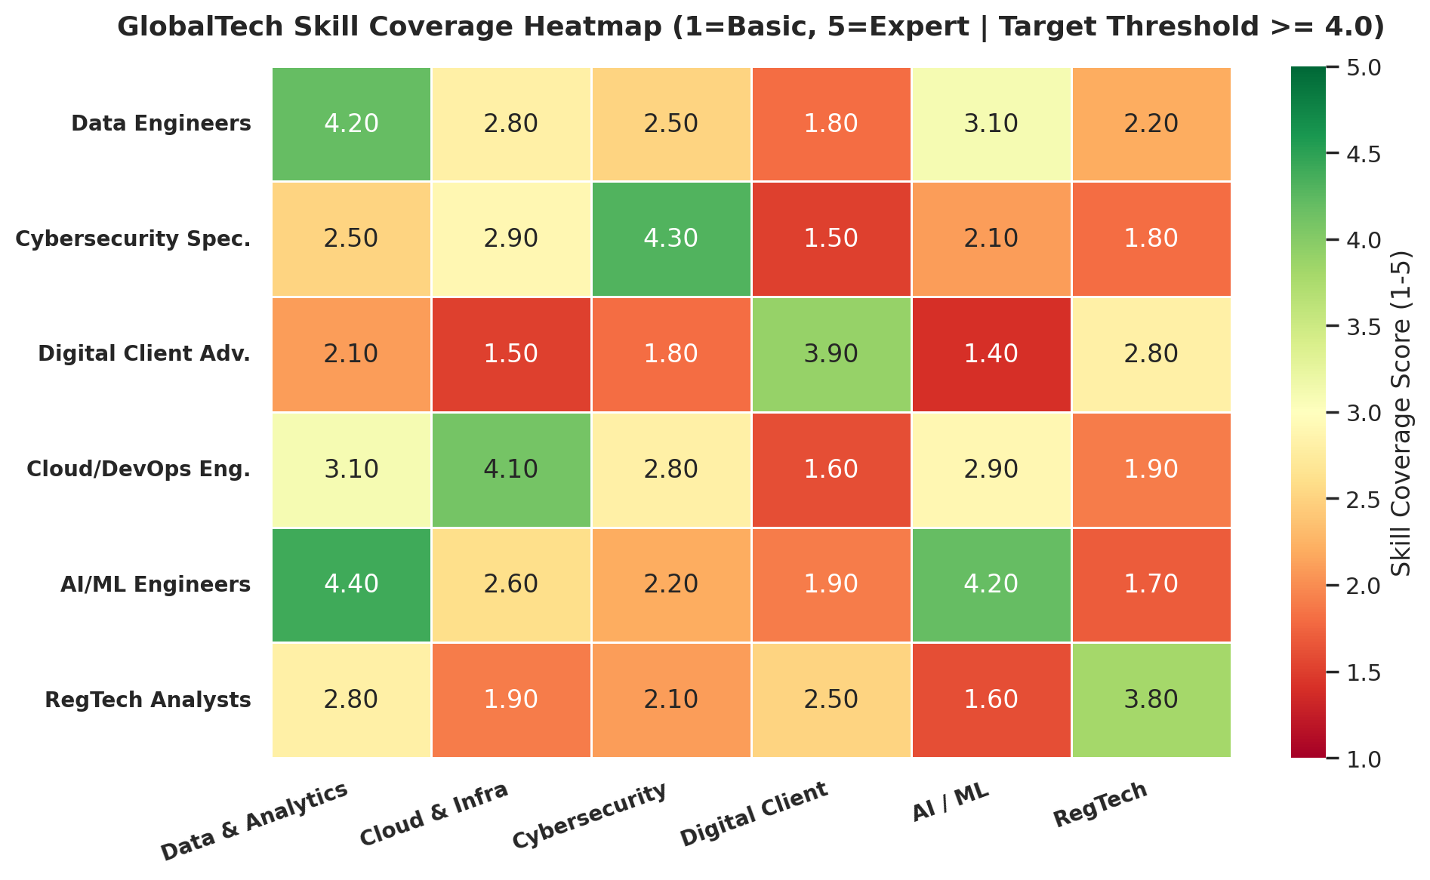
CAPSTONE PROJECT PORTFOLIO
Current State Assessment & Skill Coverage Deficits
Skill Deficiency Diagnostics
Baseline Workforce: 364 total FTEs across 6 technical role segments evaluated on a 1.0 to 5.0 proficiency scale.
AI/ML Deficit (2.83 Score): Severe deficiency in neural network optimization and predictive modeling capabilities.
Cybersecurity Vulnerability (2.52 Score): Critical shortage in cloud threat prevention and regulatory reporting automation.
Cloud Infrastructure (2.73 Score): Gaps in DevOps CI/CD pipeline automation and Kubernetes container orchestration.
Reskilling Opportunity: Digital Advisors show strong foundational scores (3.80), making them prime candidates for upskilling.

Slide 4
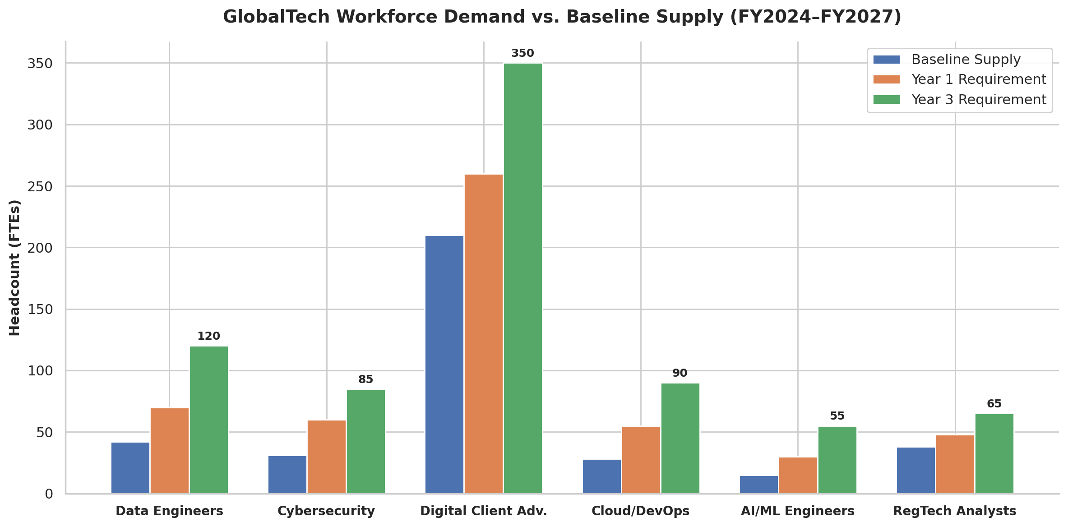
CAPSTONE PROJECT PORTFOLIO
Multi-Horizon Headcount Demand Trajectory (Y1–Y3)
Headcount Shortfall Breakdown
Year 1 (FY2025): Demand reaches 523 FTEs (+159 gap). Immediate expansion required for Cybersecurity (+29) and Data Engineering (+28).
Year 2 (FY2026): Demand expands to 649 FTEs (+282 cumulative gap) as digital banking features go live.
Year 3 (FY2027): Target reaches 765 FTEs (+401 cumulative net gap across all six priority segments).
Digital Advisors (+140 Gap): Largest absolute headcount gap, completely addressed via 90 internal reskills + 50 external hires.
Data Engineers (+78 Gap): Highest relative shortage ratio (185% growth over baseline supply).

Slide 5
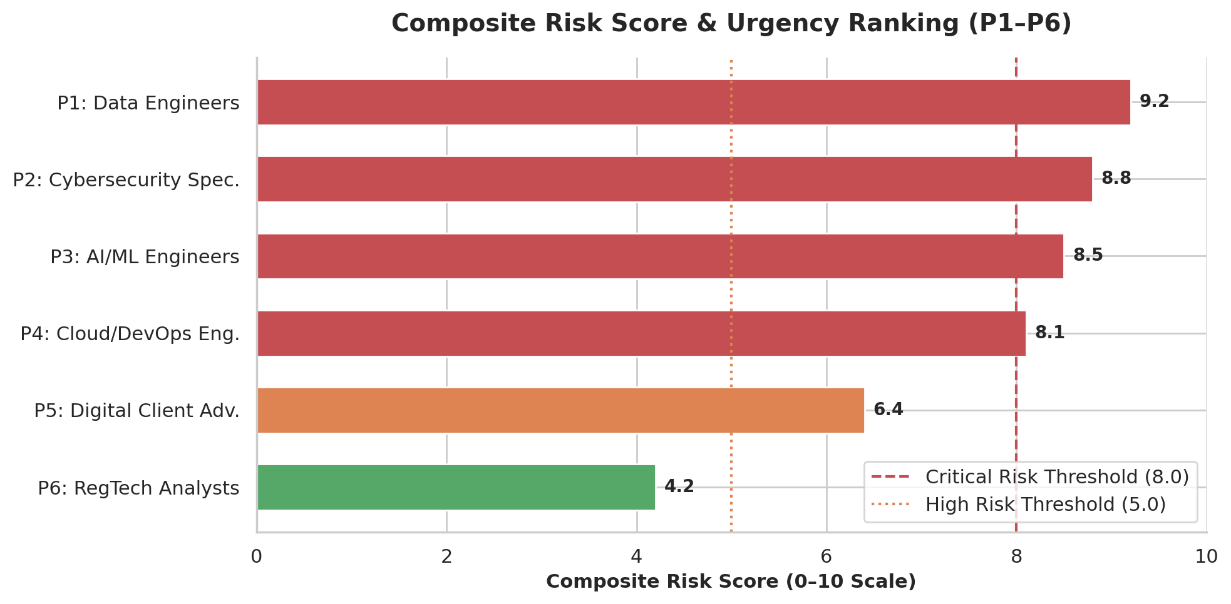
CAPSTONE PROJECT PORTFOLIO
Composite Risk Score & Role Priority Ranking
Priority Risk Governance
Risk Formula: 40% Gap Magnitude + 35% Attrition Risk + 25% Skill Scarcity.
P1 Data Engineers (9.2 Score): Critical priority due to +78 gap, 18.0% turnover, and market talent scarcity.
P2 Cybersecurity (8.8 Score): High urgency driven by Q4 2024 compliance audit deadlines.
P3 AI/ML Engineers (8.5 Score): Portfolio-highest 20.0% turnover rate ($105K replacement cost per FTE).
Turnover Financial Exposure: Total 3-year turnover cost exposure equals $22.19M across the portfolio.

Slide 6
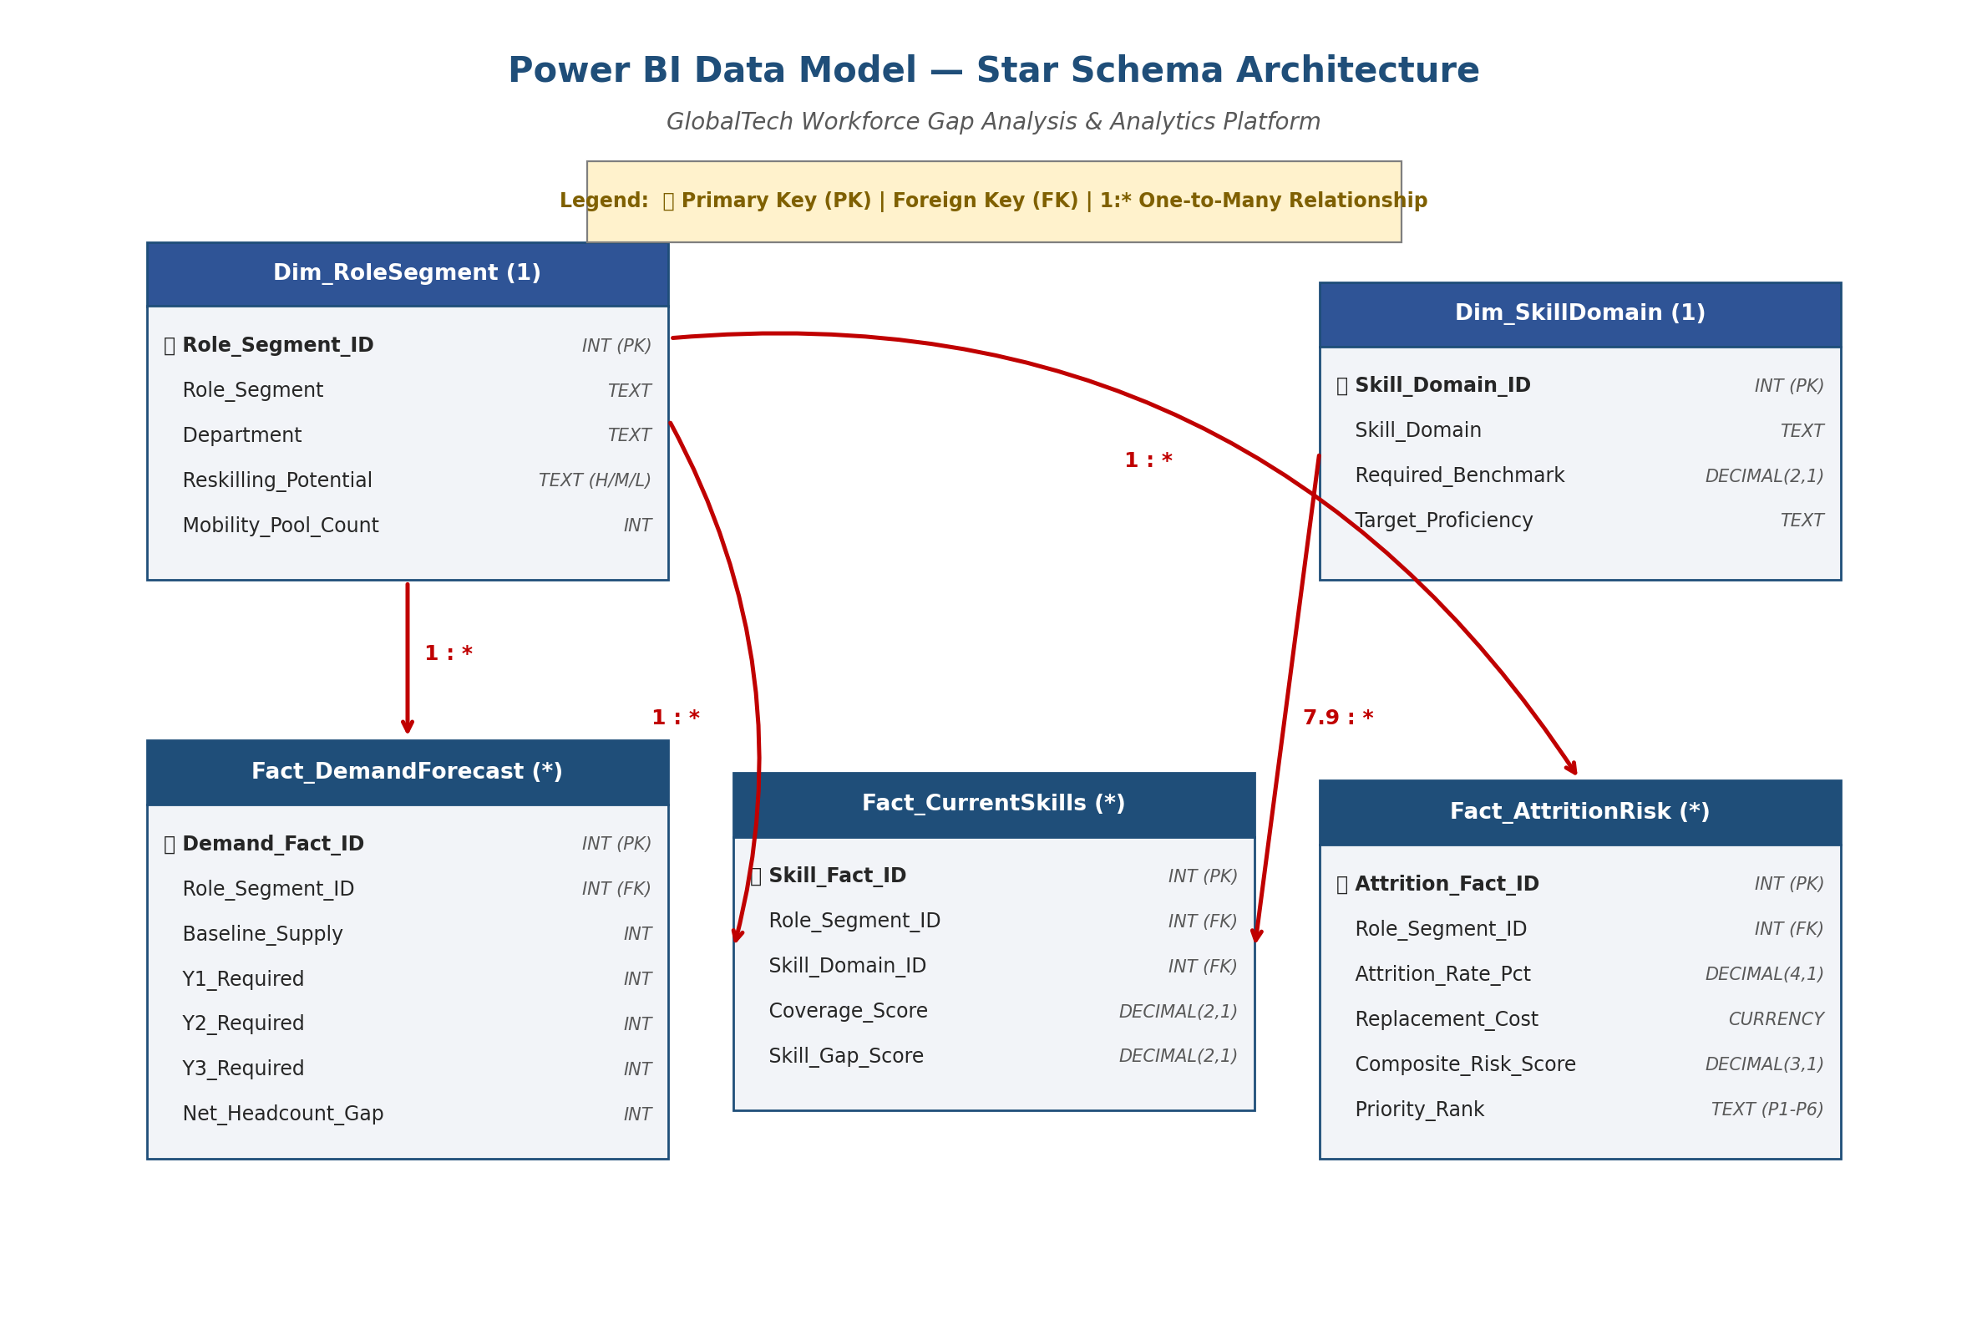
CAPSTONE PROJECT PORTFOLIO
Power BI Technical Architecture & Data Model
Star Schema Principles
Central Dimensions: dim_rolesegment, dim_skill_domain, dim_horizon contain clean attributes.
Fact Tables: fact_demand_forecast, fact_current_skills, fact_attrition_risk hold quantitative metrics.
1:* Cardinality: Strict 1-to-many single direction relationships prevent circular references and optimization drag.
Bidirectional Cross-Filtering: Set between dim_rolesegment and fact_attrition_risk to allow Risk Rating slicers to filter upstream across all 4 visuals.
Granularity Alignment: Separates multi-horizon projections (Visuals 1 & 4) from point-in-time baseline audits (Visuals 2 & 3).

Slide 7
CAPSTONE PROJECT PORTFOLIO
Dynamic DAX Measures Library & Slicer Logic
1. Dynamic Demand FTEs Measure
Selected_Demand_FTEs =
SWITCH(
SELECTEDVALUE('dim_horizon'[Horizon_ID]),
1, [Sum_Demand_Y1],
2, [Sum_Demand_Y2],
3, [Sum_Demand_Y3],
[Sum_Demand_Y3]
)
Dynamically switches headcount demand targets based on user horizon selection.
2. Conditional Formatting Hex Color Measure
Heatmap_Cell_Color_Hex =
VAR Score = [Avg_Coverage_Score]
RETURN SWITCH(
TRUE(),
Score < 2.0, "#C00000", -- Dark Red
Score < 3.0, "#ED7D31", -- Orange
Score < 4.0, "#FFC000", -- Yellow
"#70AD47" -- Green
)
Drives dynamic background color formatting for Visual 2 heatmap cells.
3. Phased Talent Investment Measure
Selected_Talent_Spend_M =
SWITCH(
SELECTEDVALUE('dim_horizon'[Horizon_ID]),
1, 21.30,
2, 16.30,
3, 46.10,
46.10
)
Updates center donut chart budget display as horizon slicers are toggled.

Slide 8
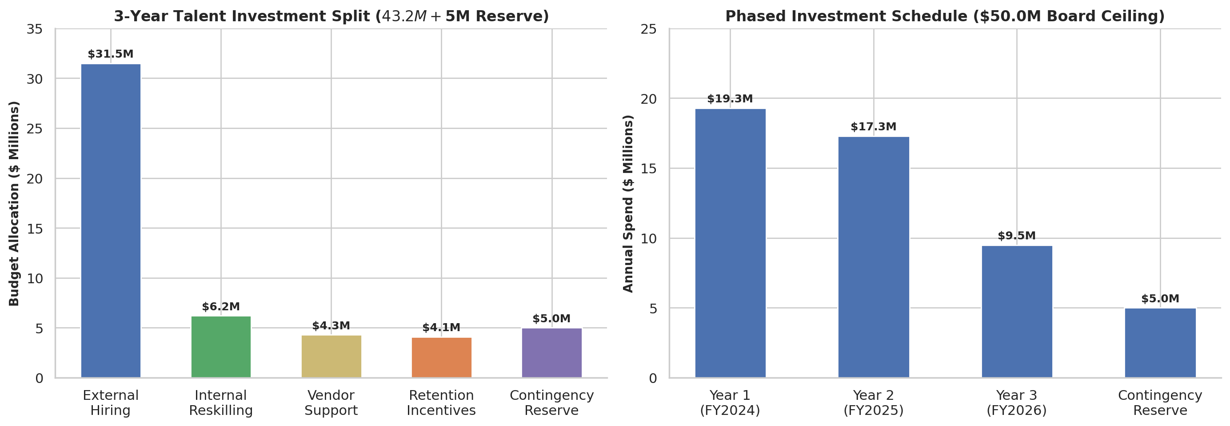
CAPSTONE PROJECT PORTFOLIO
Phased Financial Spend Allocation & Transformation ROI
Financial Capital Allocation
Direct External Hiring ($31.50M): 234 external hires focused on P1 Data Engineers and P2 Cybersecurity.
Internal Reskilling ($6.20M): 167 internal conversions saving ~$14.5M in recruiter commission fees.
Retention Incentives ($4.10M): Targeted stay-bonuses for high-risk AI/ML and Data Science personnel.
Vendor / Consulting ($4.30M): Bridge capacity during Year 1 ramp-up to guarantee audit readiness.
Reserve Compliance: $46.10M spend + $5.0M contingency reserve leaves $3.90M buffer under $50.0M board ceiling.

Slide 9
CAPSTONE PROJECT PORTFOLIO
Strategic Recommendations & Implementation Roadmap
Immediate Execution Priorities
• 1. Fast-Track Y1 Cyber & Data Hiring: Deploy $14.2M in Year 1 toward Cybersecurity (+29 FTEs) and Data Engineering (+28 FTEs) to meet Q4 2024 compliance audit deadlines.
• 2. Launch Advisory Reskilling Academy: Convert 90 Traditional Retail Advisors to Digital Client Advisors via a 12-week upskilling bootcamp, saving $7.8M in recruiting fees.
• 3. Deploy AI/ML Stay Bonuses: Allocate $2.5M toward milestone equity vests and stay-bonuses to reduce AI/ML turnover from 20% to 12%.
Governance & PMO Cadence
• 4. Stage-Gated Budget Release: Release Year 2 ($16.3M) and Year 3 ($8.5M) funds in quarterly tranches contingent on reskilling completion and audit compliance.
• 5. Operationalize Power BI PMO Cadence: Embed the dynamic Power BI dashboard into monthly C-suite reviews to track hiring velocity and reskilling milestones.
• 6. Maintain Risk Buffer: Keep $3.90M unallocated buffer locked to hedge against market compensation spikes or unexpected turnover.

